Slide 1
IBM project phase 1
Problem definition and design thinking

Slide 2
Group 4
Group members
Sathya. P
Sowmiya. S
Surya. L
Swastina. S
Vasundhra. J
Vimala Devi. S

Slide 3
Content
Aim
Objective
Block diagram
Problem definition Design thinking

Slide 4
Aim
Measuring energy consumption is the first step in any approach to reducing or limiting consumption. The first measurement you will perform is the one that will serve as a reference value, in order to set up an energy saving plan that can be implemented over the next few years.

Slide 5
Objective
It provide users with data about their consumption patterns so they can make informed energy management decisions and maximize savings.

Slide 6
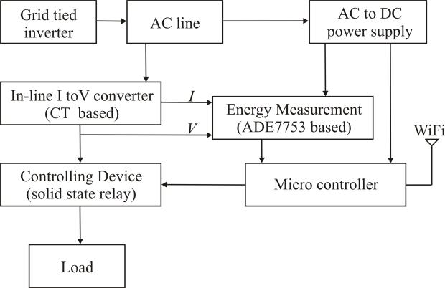
Block diagram

Slide 7
Problem definition
The problem at hand is to create an automated system that measures energy consumption, analyzes the data, and provides visualizations for informed decision-making. This solution aims to enhance efficiency, accuracy, and ease of understanding in managing energy consumption across various sectors.

Slide 8
Design thinking
Data source
Data preprocessing
Feature extraction
Model development
Visualization
Automation

Slide 9
Data source
Identify an available dataset containing energy consumption measurements.

Slide 10
Data preprocessing
Clean, transform, and prepare the dataset for analysis.

Slide 11
Feature extraction
Extract relevant features and metrics from the energy consumption data.

Slide 12
Model development
Utilize statistical analysis to uncover trends, patterns, and anomalies in the data.

Slide 13
Visualization
Develop visualizations (graphs, charts) to present the energy consumption trends and insights.

Slide 14
Automation
Build a script that automates data collection, analysis, and visualization processes.

Slide 15
Thank you

